Slide 1
Conditional Probability, Independence, and the Product Rule

Slide 2
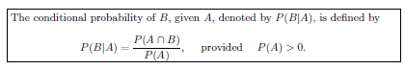
Conditional Probability
The probability of an event B occurring when it is known that some event A has occurred is called a conditional probability and is denoted by P(B|A).
The symbol P(B|A) is usually read “the probability that B occurs given that A occurs” or simply “the probability of B, given A.”

Slide 3

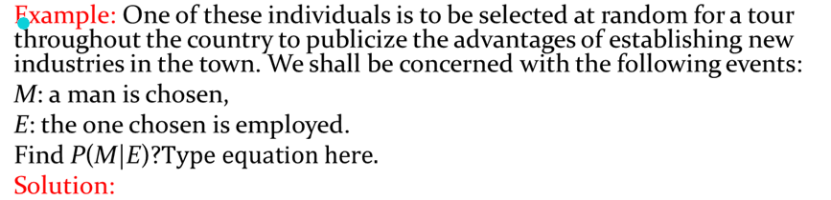
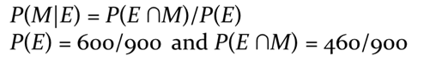


Slide 4
Example: The probability that a regularly scheduled flight departs on time is P(D) = 0.83; the probability that it arrives on time is P(A) = 0.82; and the probability that it departs and arrives on time is P(D ∩A) = 0.78. Find the probability that a plane
Arrives on time, given that it departed on time.
Departed on time, given that it has arrived on time.
Arrives on time, one is given the information that the flight did not depart on time.
Solution:
P(A|D) = P(A ∩D)/P(D) = 0.78/0.83 =0.94
P(D|A) = P(A ∩D)/P(A) = 0.78/0.82 =0.95
P(A|D´) = P(A ∩D´)/P(D´) = (0.82 − 0.78)/0.17 = 0.24

Slide 5
Example: The concept of conditional probability has countless uses in both industrial and biomedical applications. Consider an industrial process in the textile industry in which strips of a particular type of cloth are being produced. These strips can be defective in two ways, length and nature of texture. For the case of the latter, the process of identification is very complicated. It is known from historical information on the process that 10% of strips fail the length test, 5% fail the texture test, and only 0.8% fail both tests. If a strip is selected randomly from the process and a quick measurement identifies it as failing the length test, what is the probability that it is texture defective?
Solution:
Consider the events
L: length defective, T: texture defective.
Given that the strip is length defective, the probability that this strip is texture defective is given by
P(T|L) = P(T ∩ L)/P(L) = 0.008/0.1 = 0.08.
Thus, knowing the conditional probability provides considerably more information than merely knowing P(T).

Slide 6
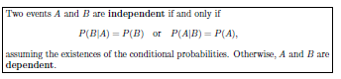
Independent Events
Two events are independent if P(B/A) =P(B).
In other words, the occurrence of A had no impact on the occurrence of B. Here the occurrence of B is independent of the occurrence of A.

Slide 7
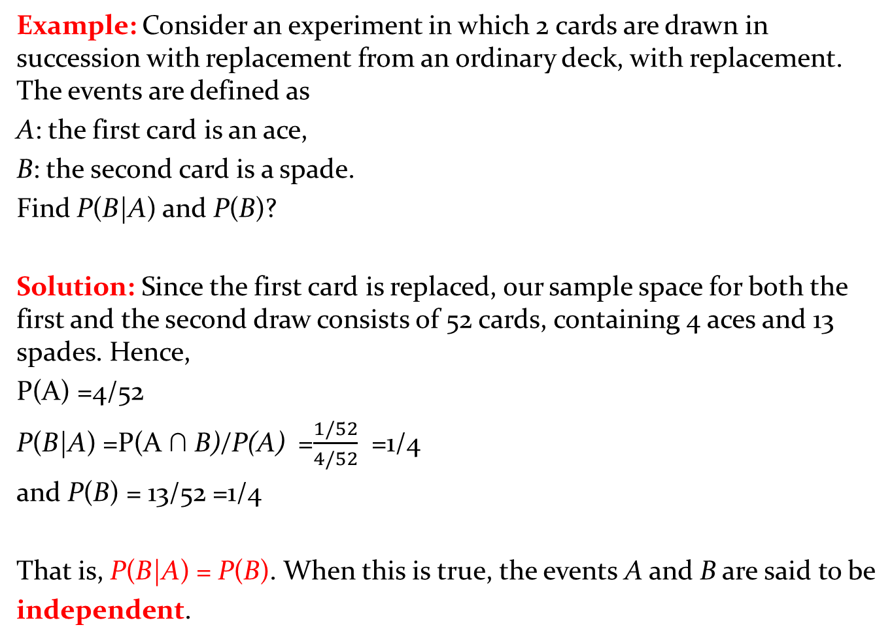
Example: Consider an experiment in which 2 cards are drawn in succession with replacement from an ordinary deck, with replacement. The events are defined as
A: the first card is an ace,
B: the second card is a spade.
Find P(B|A) and P(B)?
Solution: Since the first card is replaced, our sample space for both the first and the second draw consists of 52 cards, containing 4 aces and 13 spades. Hence,
P(A) =4/52
P(B|A) =P(A ∩ B)/P(A) =$\frac{1/52}{4/52}$ =1/4
and P(B) = 13/52 =1/4
That is, P(B|A) = P(B). When this is true, the events A and B are said to be
independent.

Slide 8
Example: The probability that a regularly scheduled flight departs on time is P(D) = 0.83; the probability that it arrives on time is P(A) = 0.82; and the probability that it departs and arrives on time is P(D ∩A) = 0.78. Find the probability that a plane
Arrives on time, given that it departed on time.
Departed on time, given that it has arrived on time.
Determine whether A and B are independent events?
Solution:
P(A|D) = P(A ∩D)/P(D) = 0.78/0.83 =0.94
P(D|A) = P(A ∩D)/P(A) = 0.78/0.82 =0.95
P(A|D) ≠ P(A)
0.94 ≠ 0.83
P(D|A) ≠ P(D)
0.95 ≠ 0.82
Hence A and B are not independent events.

Slide 9
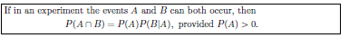
The Product Rule, or the Multiplicative Rule (For Not Independent Events)
Without Replacement
Thus, the probability that both A and B occur is equal to the probability that A occurs multiplied by the conditional probability that B occurs, given that A occurs.
Since the events A ∩ B and B ∩ A are equivalent, it follows from Theorem
P(A ∩ B) = P(B ∩ A) = P(B)P(A|B).

Slide 10
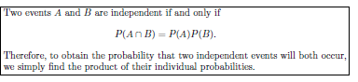
The Product Rule, or the Multiplicative Rule (For Independent Events)
With Replacement
Thus, the probability that both A and B occur is equal to the probability that A occurs multiplied by the probability that B occurs.
Since the events A ∩ B and B ∩ A are equivalent, it follows from Theorem
P(A ∩ B) = P(B ∩ A) = P(B)P(A).

Slide 11
Example: Suppose that we have a fuse box containing 20 fuses, of which 5 are defective. If 2 fuses are selected at random and removed from the box in succession without replacing the first, what is the probability that both fuses are defective?
Solution:
Let A be the event that the first fuse is defective and B the event that the second fuse is defective.
P(A ∩ B) = P(A)P(B/A)
=(5/20)(4/19)
= 1/19

Slide 12
Example: A small town has one fire engine and one ambulance available for emergencies. The probability that the fire engine is available when needed is 0.98, and the probability that the ambulance is available when called is 0.92. In the event of an injury resulting from a burning building, find the probability that both the ambulance and the fire engine will be available, assuming they operate independently.
Solution:
Let A and B represent the respective events that the fire engine and the ambulance are available. Then
P(A ∩ B) = P(A)P(B) = (0.98)(0.92) = 0.9016.

Slide 13
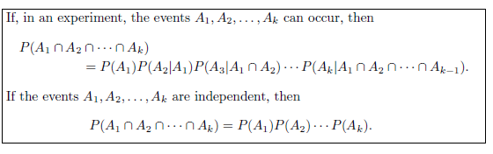

Slide 14


Example: Three cards are drawn in succession, without replacement, from an ordinary deck of playing cards. Find the probability that the event A1 ∩ A2 ∩ A3 occurs, where A1 is the event that the first card is a red ace, A2 is the event that the second card is a 10 or a jack, and A3 is the event that the third card is greater than 3 but less than 7.
Solution :
A1: the first card is a red ace,
A2: the second card is a 10 or a jack,
A3: the third card is greater than 3 but less than 7

Slide 15
Assignment Page No 69
2.74
2.75
2.76
2.77
2.78
2.80
2.81
2.82
2.83
2.84
2.85
2.89

